Slide 1
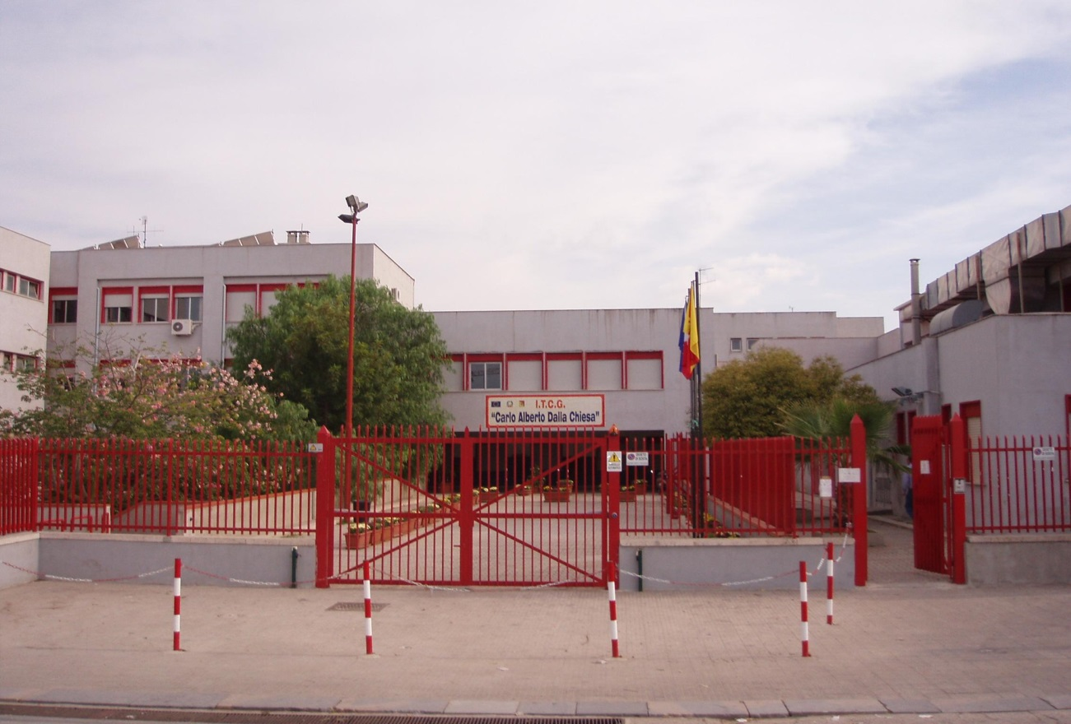
“IT DALLA CHIESA”
SCHOOL IN PARTINICO PARTINICO
Corso dei Mille, 517 – 90047 PARTINICO tel. 0918781948 / 0918782815 – fax 0918781274
www.itdallachiesa.gov.it - patd09000p@istruzione.it
IT CARLO ALBERTO DALLA CHIESA

Slide 2
We are students of the school “Carlo Alberto Dalla Chiesa”, in Partinico. Our school is attended by about 800 students. It’s a technical high school which offers different and specific fields of study, such as….

Slide 3
BUSINESS ADMINISTRATION
ECONOMIC
SECTOR
TOURISM
BUSINESS INFORMATION TECHNOLOGY
" C.A. DALLA CHIESA “ SCHOOL
PARTINICO
COMPUTER SCIENCE AND TELECOMMUNICATIONS
TECHNOLOGICAL
SECTOR
ENVIRONMENT, SURVEYING AND CONSTRUCTION MANAGEMENT
CHEMISTRY AND BIOTECHNOLOGY

Slide 4
Our school has different floors: the basement, the ground floor, the first floor and the second one.
In the basement, there are some classrooms.
On the ground floor, there is a digital library and a paper library, a large auditorium, a gym, many offices and some classrooms
On the first floor and on the second one, there are some classrooms.
The branch school is a few hundred meters far from our main school. It is attended by the students that are going to specialize in “tourism”.

Slide 5
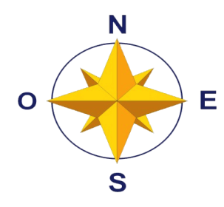
The school has 7 laboratories:
foreign language Lab
ICT Lab
Chemistry Lab
Physics Lab
every classroom has its LIM and computer wireless connection.
“C. A. Dalla Chiesa” School

Slide 6
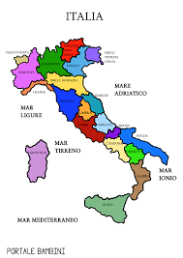
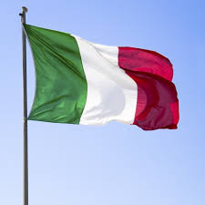
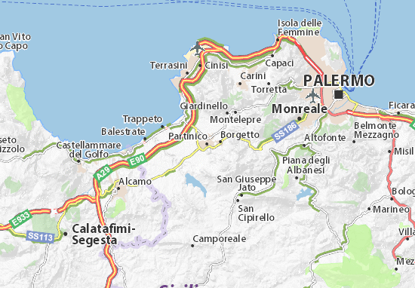
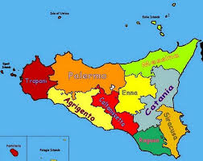
PARTINICO - ITALY

Slide 7
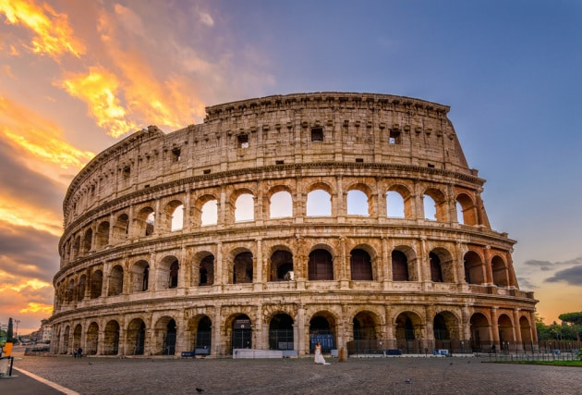
ITALY
Today people mainly come to Italy for its rich art, history, cuisine, fashion, culture, beaches, mountains and monuments. Italy’s capital is Rome and in Rome there is the Papal Basilica of Saint Peter within the Vatican City.

Slide 8
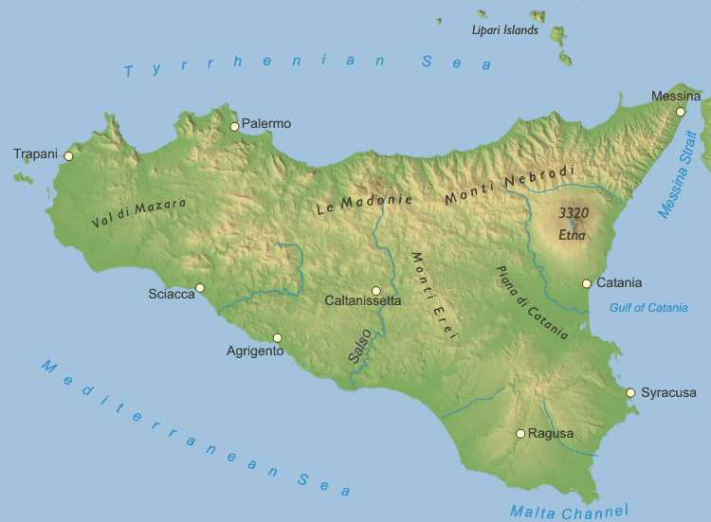
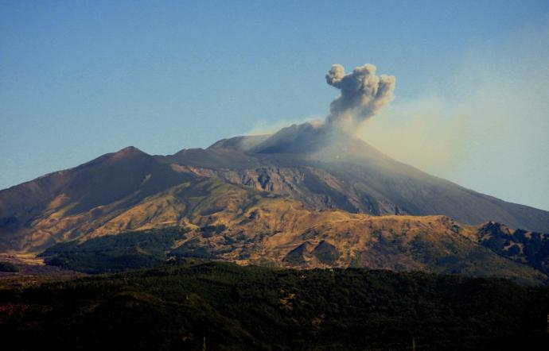
Sicily
Sicily is the largest island in Italy. It is famous for its archeology, art, seascape, mild climate and unique cuisine. It’s also home to Mount Etna, Europe’s largest active vulcano. There are smaller islands such as the Aeolian, Aegadean, Pelagian archipelagos and Pantelleria.

Slide 9
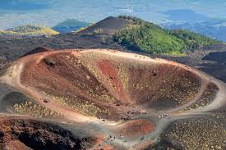
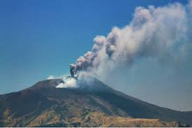
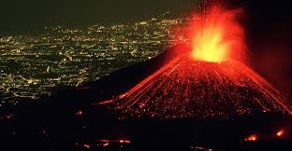
MOUNT ETNA
Mount Etna is one of the most representative symbol of Sicily.
It is the highest volcano in Europe and one of most active of the world. Its impressive size (more than 3327 meters high with a diameter of 40 km) overlooks the whole region. Its spectacular eruptions and its fiery lava flows, have always aroused the interest of scientists along with the curiosity of visitors from all over the world.

Slide 10
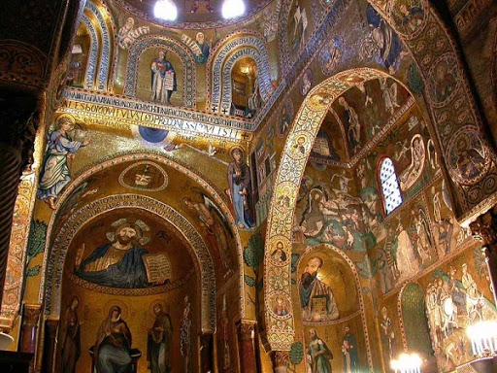
Palermo
This capital city is the fifth largest in Italy. It is in the west of Sicily. The most important tourist attractions in Palermo are: Palermo Cathedral, Norman Palace, the important four corners, Cappella Palatina.

Slide 11
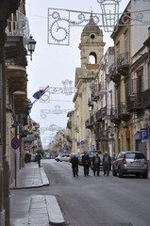
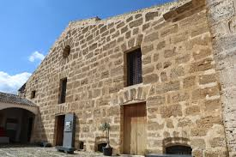
Partinico
Partinico is a town of about 32.000 inhabitants where our school is situated. It is near Palermo and Trapani. In Partinico there are some monuments: “Palchetto Musicale”, “Cantina Borbonica” and some churches.

Slide 12
Near Partinico, there are wonderful beaches and natural reserves, Greek archaeological sites like Segesta and Selinunte, the medieval town of Erice, the Arab-Norman style Cathedrals and Chapels and the magnificence of Baroque churches in Palermo (UNESCO World Heritage sites).

Slide 13
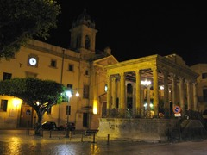
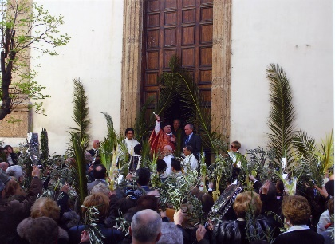
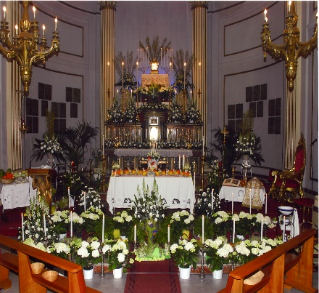
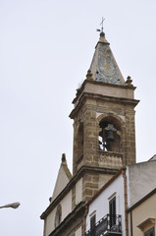
The best of Partinico
Palchetto della Musica 1875 (by night)
Maria SS Del Carmelo Church and the Annexed Monastery
(1634)
S. Leonard Church (1634)

Slide 14
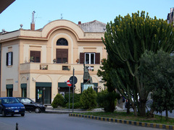
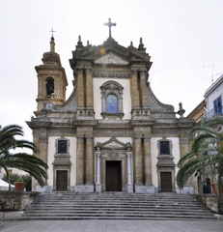
The best of Partinico
The “Otto Cannoli” Fountain in “Duomo” Square
The Monument to the Unknown Soldier
The Cathedral “Maria SS Annunziata” (1552-1570)
The “Bonura Tower”

Slide 15
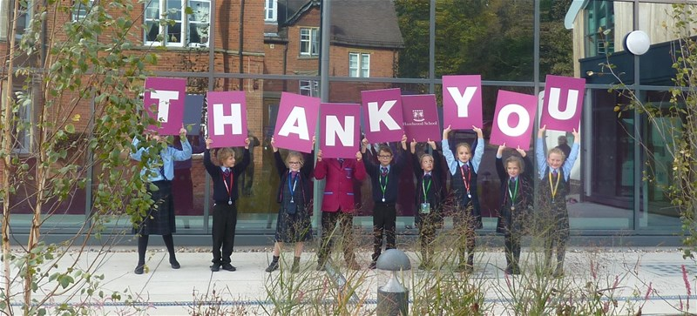
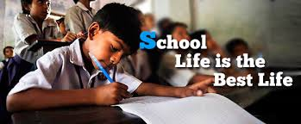
…for your attention!
I wish you a lot of joy for your life and for your school life!!!!

