Slide 1
Our polish school
By Magdalena Kuta and Malwina Matysiak

Slide 2
Important moments in THE history our school

Slide 3
Building the foundation act for the construction of a new school
19th September 1965

Slide 4
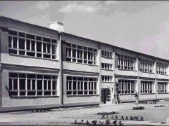
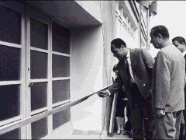
Open school in the new building
1st September 1967

Slide 5
The school receives the name of Adam Mickiewicz
26th November 1977

Slide 6
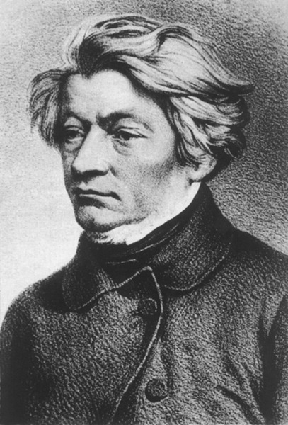
Our patron
Adam Bernard Mickiewicz (born December 24, 1798 in Zaosie or Nowogródek, died November 26, 1855 in Istanbul) - Polish poet, political activist, publicist, translator, philosopher, religious activist, military organizer and commander, academic teacher. With Juliusz Słowacki and Zygmunt Krasiński, he is the one of the greatest poet of Polish Romanticism and Polish literature, and even considered one of the greatest Europeans.

Slide 7
The most important of Mickiewicz:
"Reduta Ordona",
"Sonety krymskie",
"Oda do młodości",
poem "Do M***",
"Konrad Wallenrod",
"Dziady" ,
"Pan Tadeusz".

Slide 8
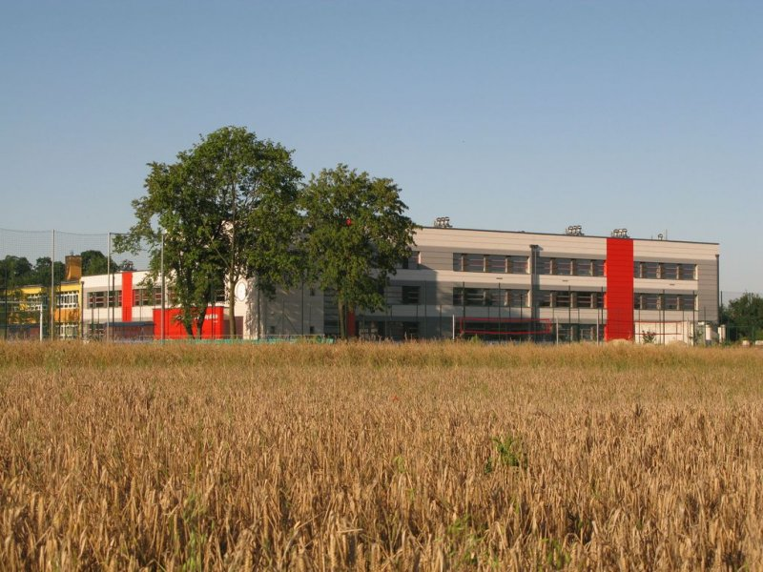
This is our primary school. Children and teenagers from 6 to15 years old study here. We've got 32 teachers and about 350 students.

Slide 9
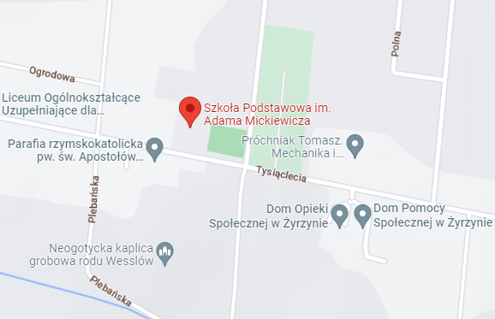
Our school is in Żyrzyn. It is the only one school in this place. It on Tysiąclecia 143 Street. Near the school there is the nineteenth-century, classical style church.

Slide 10
Our school day
All grades start lessons at 8 am but each one finishes at different times. Grades 1st-3rd usualy finish at 12:25 pm, 4th-6th at 13:25 pm and 7th-8th at 14:25pm.

Slide 11
Our classrooms
3 classrooms for Polish lessons
2 classrooms for Math
2 classrooms for English
German classroom
Geography, D&T and education for safty classroom
Biology and Art clasroom
History and cityzenship education classroom
Chemistry and physic classrom
2 IT classrooms
2 PE classrooms
Religion classroom
6 classrooms for 1st-3rd grades

Slide 12
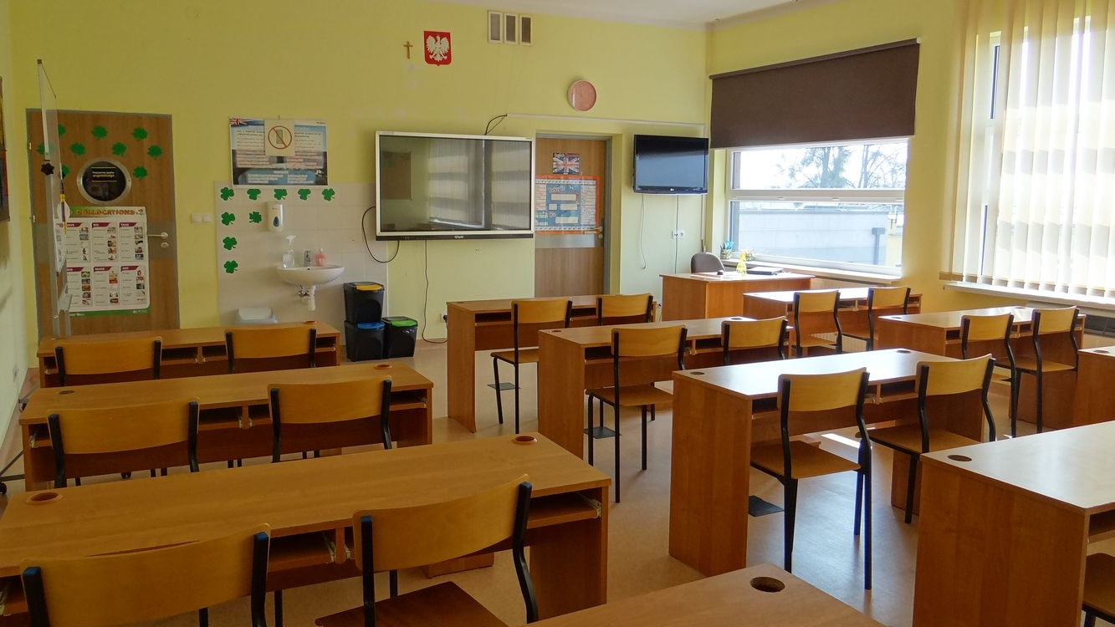
English
classroom

Slide 13
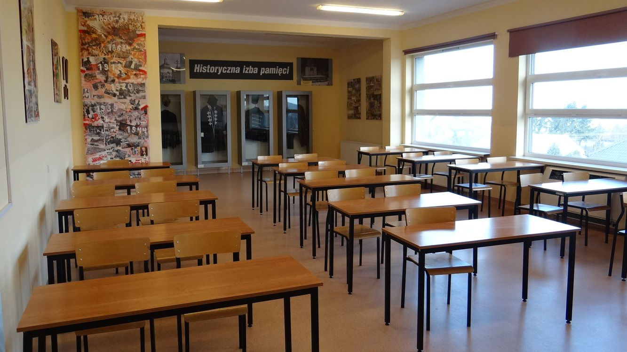
History
classroom

Slide 14
Foreign language
In our school we study two foreign languages: English and German

