Slide 1
Environmental Pollution

Slide 2
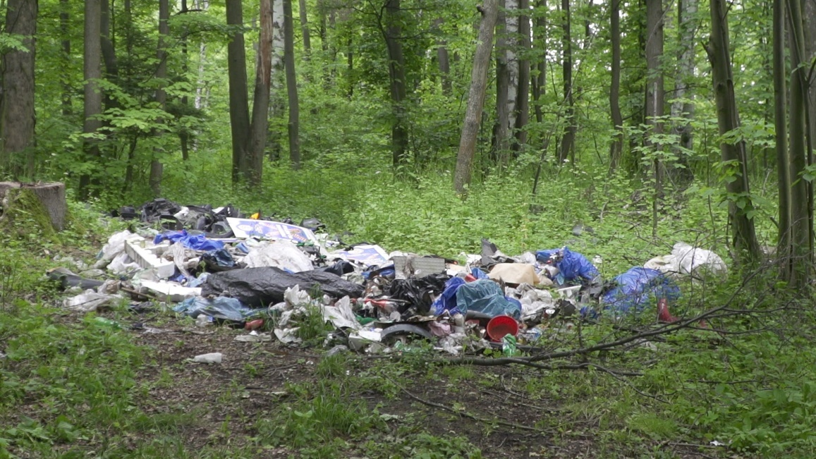
What is Environmental Pollution?
Environmental Pollution occurs when an amount of any substance or any form of energy is put into the environment at a rate faster than it can safely stored. The term pollution can refer to both artificial and natural materials that are created, consumed, and discarded in an unsustainable manner.

Slide 3
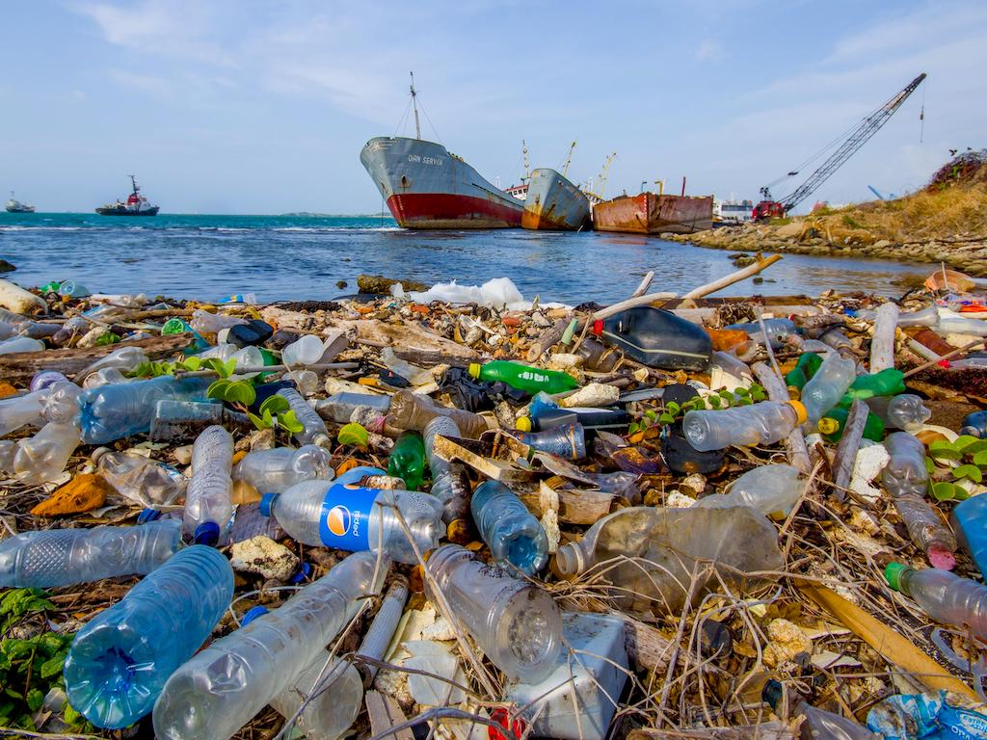
Types of Environment Pollution
Air Pollution
Soil Pollution
Water pollution
Noise Pollution
Light pollution
Radioactive/Nuclear Pollution
Thermal Pollution

Slide 4
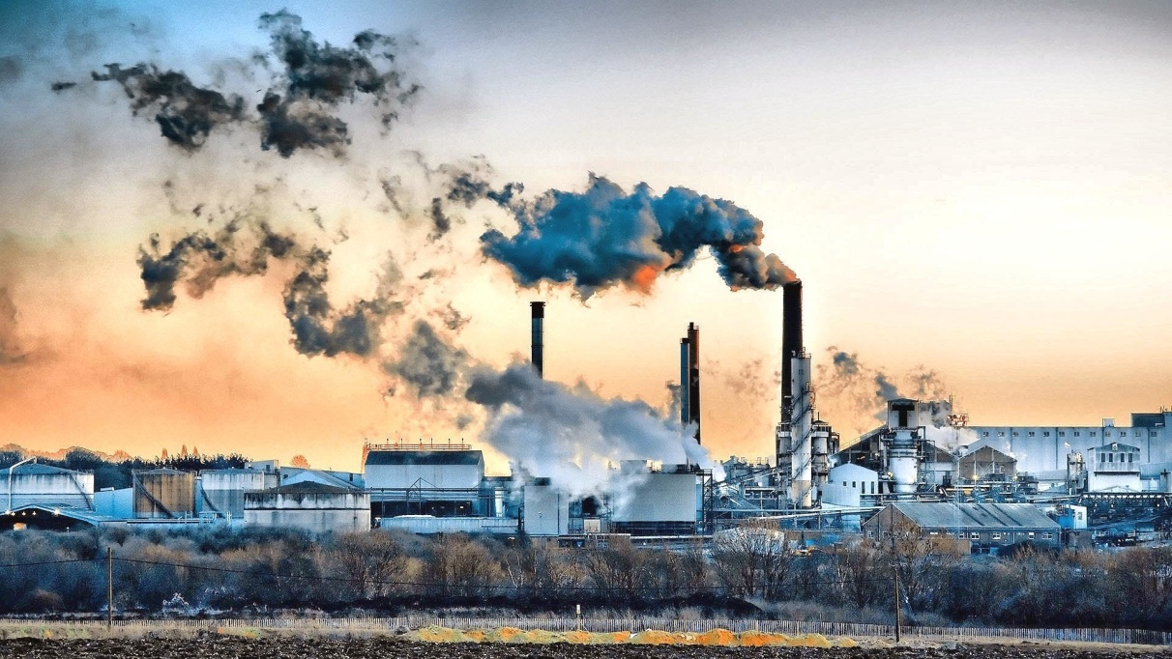
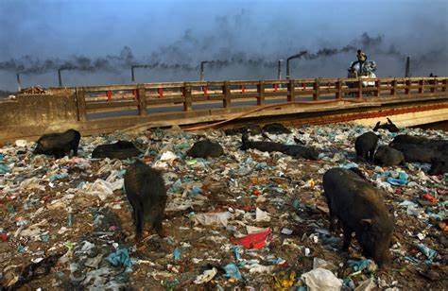
Air Pollution
Soil Pollution
Air pollution is contamination of environment by any chemical, physical or biological agent that modifies the atmosphere.
Soil pollution is the presence of toxic chemicals (pollutants or contaminants) in soil, in high concentrations to pose a risk to human health and the ecosystem.

Slide 5
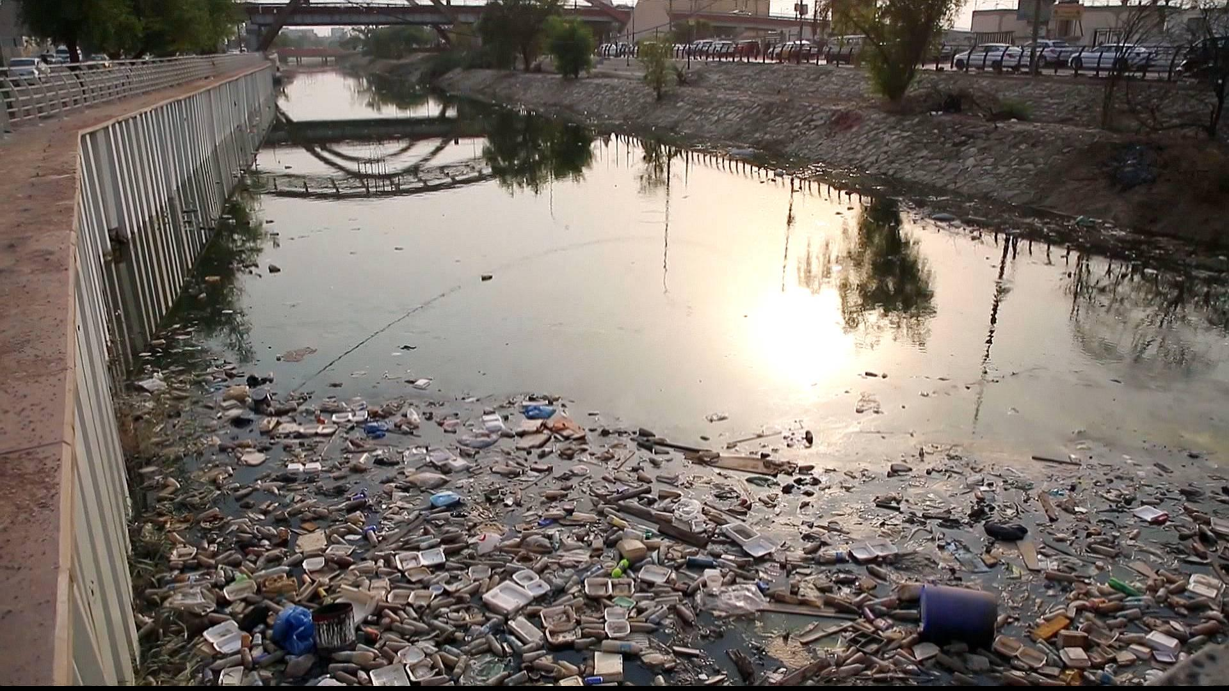
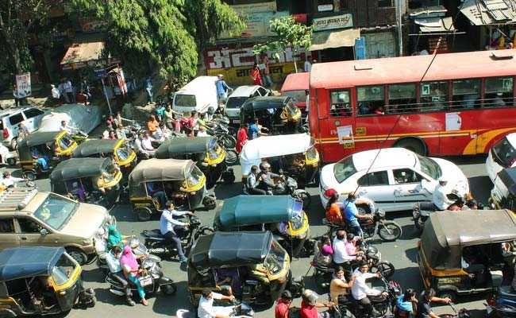
Water Pollution
Noise Pollution
Water pollution is the contamination of water, usually as a result of human activities, so that it negatively affects its uses. Water in the meaning of lakes, rivers, oceans, aquifers, reservoirs and groundwater.
Noise pollution, unwanted or excessive sound that can have harmfull effects on human, wildlife, and environment. Noise pollution comes from workplaces, roads, rails, and air traffic and from construction activities.

Slide 6
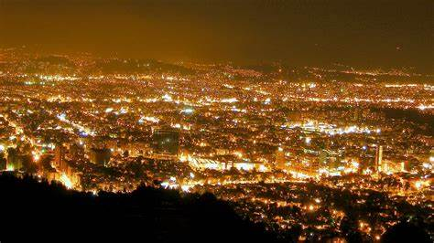
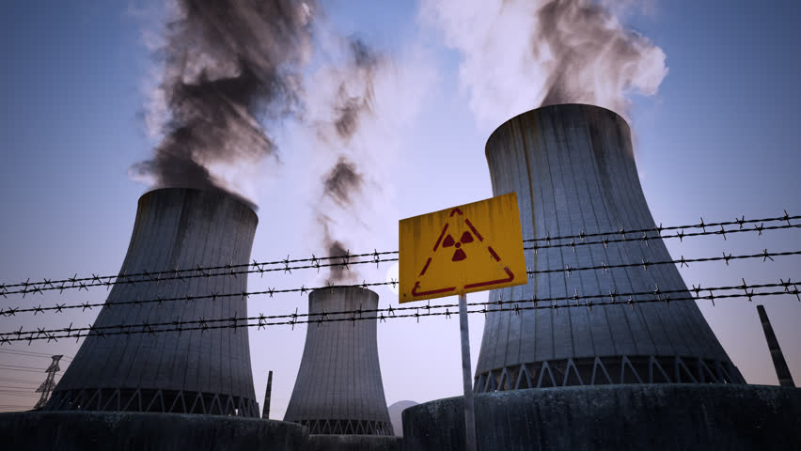
Light Pollution
Radioactive/Nuclear Pollution
Light pollution is the presence of unwanted, inappropriate, or excessive artificial light. The term light pollution refers to the effects of any poorly implemented light, during the day or night.
Radioactive/Nuclear Pollution is the deposition, or presence of radioactive substances on surfaces or within solids, liquids, or gases (including the human body), where their presence is unintended or undesirable.

Slide 7
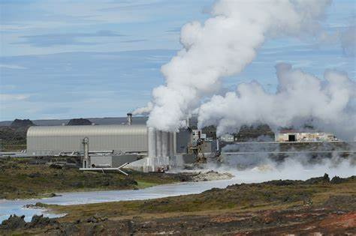
Thermal Pollution
Thermal pollution, sometimes called "thermal enrichment", is the degradation of water quality by any process that changes water temperature. Thermal pollution is the rise or fall in the temperature of a natural body of water caused by human influence.

Slide 8
The impact of environmental pollution on our planet
-Contamination of water and soil again.
-Affecting the plant world, disrupting the processes of photosynthesis, transpiration and respiration.
-An impact, on a global scale, on climate change.

Slide 9
Environmental Pollution can be minimized by the following methods:
Planting more trees
Using low-sulfur coal in industry
Using the public transport system
Taking care of the proper disposal of your pets’ waste
Taking your bag with you when shopping. ALWAYS
Quitting smoking, or at least not throwing asses on the ground.
Keepping our cars in good working order to avoid emissions.

Slide 10
THE END By Gabriel Pokora

